Slide 1
AI For Computer Games
GAM 376/476

Slide 2
Outline for Today
Introductions
Syllabus
A.I.
Game A.I.
Course Tools
State Machines

Slide 3
AI
Artificial Intelligence
What is it?
Shortest Definition
“Intelligence exhibited by machines
Wikipedia
Very hard to define.
Because intelligence is hard to define

Slide 4
What is A.I.?
One clear point:
Its not natural, man-made
It can reason, make decisions with a variety of parameters
Similar to the human brain
Trying to replicate the Human Brain?

Slide 5
What is A.I.?
Difference between AI & Machine Learning?
Machine Learning is software that learn from examples.
You don’t code the machine learning algorithms
You train them on large sets of data.
Neural Networks
Machine Learning is one aspect of AI.
AI is broader.

Slide 6
What is A.I.?
Difference between AI & Machine Learning?
Machine Learning is software that learn from examples.
You don’t code the machine learning algorithms
You train them on large sets of data.
Neural Networks
Machine Learning is one aspect of AI.
AI is broader.

Slide 7
Current AI progress
Humanity has created “Narrow” AI
(ANI)
AI that can perform a simple task extremely well.
Better then humans majority of the time
Examples:
Chess
Sales Prediction
Weather Forecast

Slide 8
Narrow AI (ANI)
Difficult problems
Facial Recognition
Speaking Languages
Intuitive Leaps
Creative
Trivial problems for humans
These problems are still considered Narrow AI

Slide 9
Narrow AI
Narrow AI works within a very limited context
Can’t adapt to anything outside the realm of its field
Also called “Weak” AI
Not to say its inefficient.
Majority of the time they can replace jobs of humans
Possible Danger?

Slide 10
AI Threat?
Recent debate in the news over the potential threat of advancement in AI
Stephen Hawking, Elon Musk
What is the threat?
Potential Levels of AI
Artificial General Intelligence
(AGI)
Artificial Super Intelligence
(ASI)

Slide 11
General AI (AGI)
Also known as Strong AI
Equivalent of Human Intelligence.
Replicating the power of the human brain
How far away are we from developing Strong AI?
More we delve into what human level intelligence is, the more we realize how powerful the human mind is.

Slide 12
General AI
Examples
Decision Making
We can take past memories and experiences from variety of different areas in a quick amount of time to make a difficult decision. Some of even done sub-consciously.
Abstract thought
Computers can process data faster then humans
Humans can think, plan, and solve problems at a general level without going into deep detail
Innovation
We can come up with thoughts and ideas with no precedence.

Slide 13
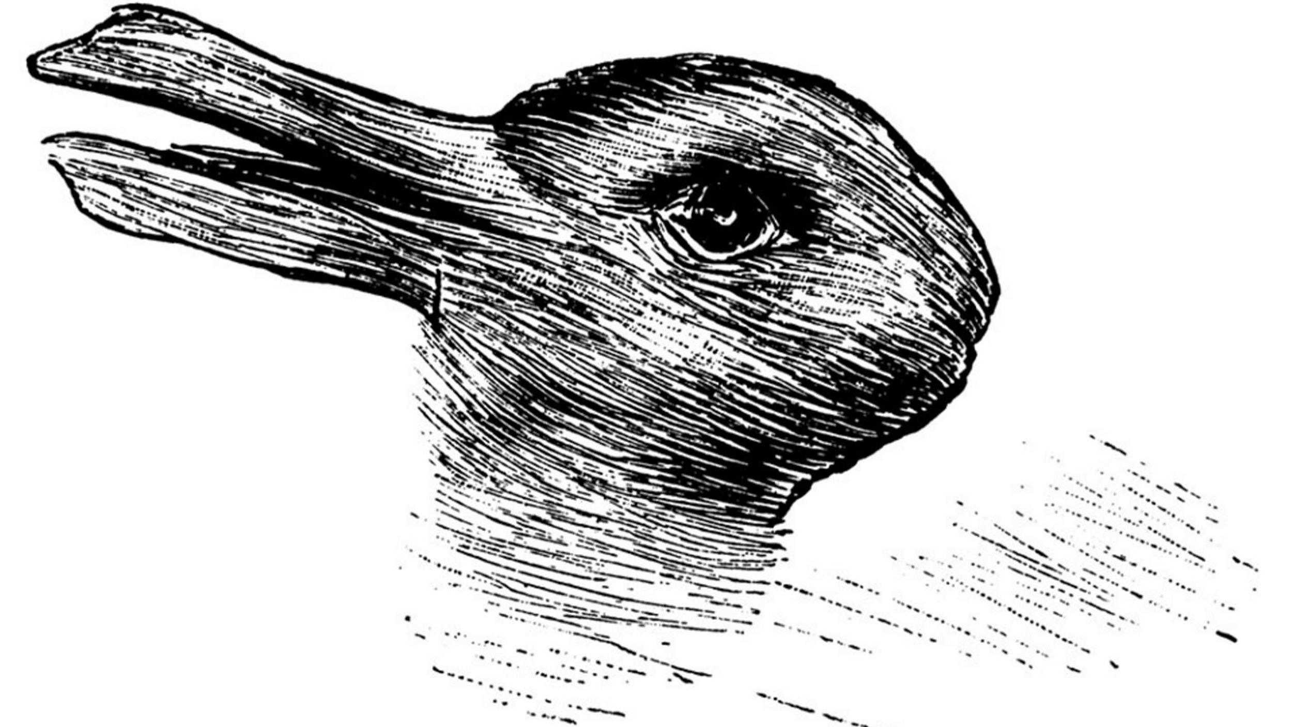
General AI
Examples
Perception
Duck or Rabbit?

Slide 14
General AI
Make a computer read a 6-year old picture book
Not only have the computer understand the words but the meaning behind them
Think how easy our brains are able to navigate and interact with 3D environment.
Hand to Eye coordination

Slide 15


General AI Test
What shapes are in this image?
What shapes are in this image?

Slide 16
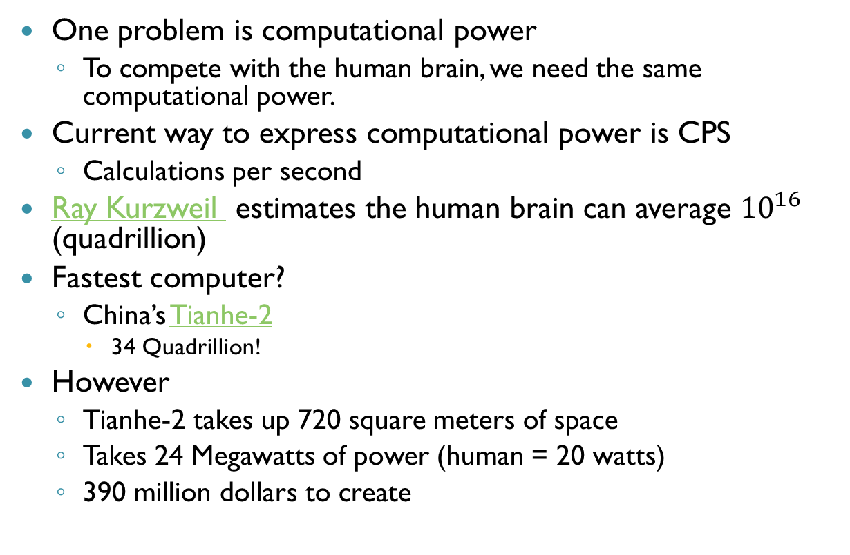
Creating General AI
One problem is computational power
To compete with the human brain, we need the same computational power.
Current way to express computational power is CPS
Calculations per second
Ray Kurzweil estimates the human brain can average ${10}^{16}$ (quadrillion)
Fastest computer?
China’s Tianhe-2
34 Quadrillion!
However
Tianhe-2 takes up 720 square meters of space
Takes 24 Megawatts of power (human = 20 watts)
390 million dollars to create

Slide 17
General AI
Tianhe-2
Can exceed human computational power but it is horribly inefficient
Moore’s Law
World’s maximum computing power doubles every 2 years.
Which has been pretty much spot on.

Slide 18
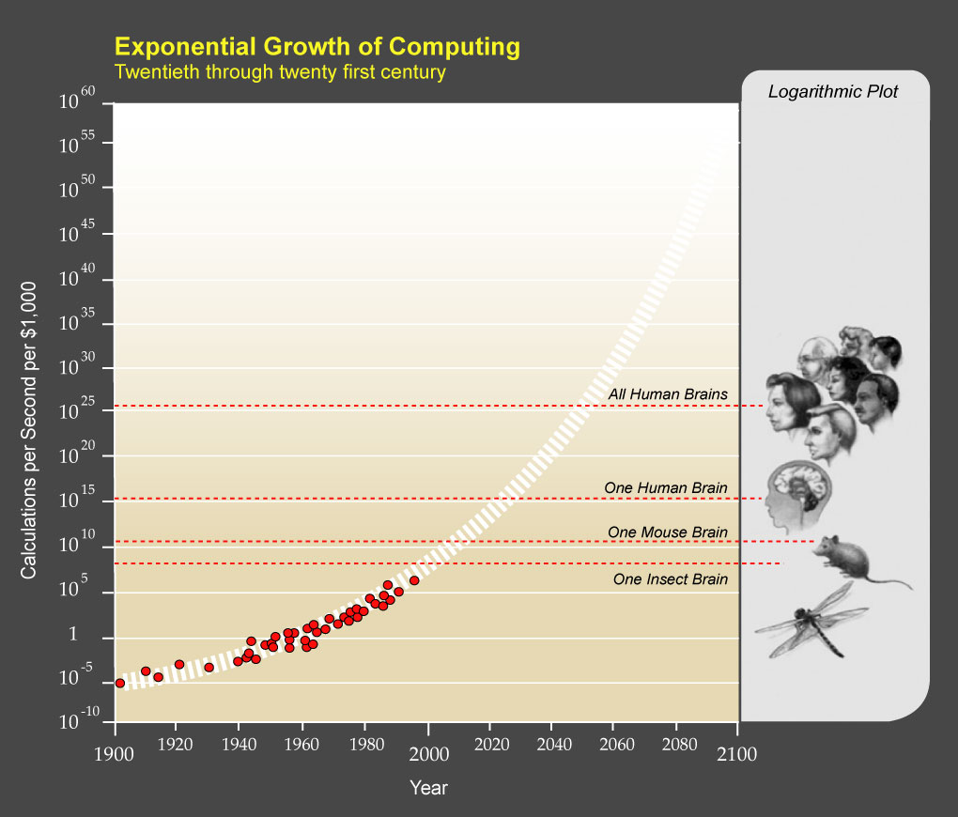
General AI

Slide 19
General AI
2nd Problem: Intelligence (Humanlike)
We know its possible (nature has shown us that)
Genetic Algorithms
Mimics natures, takes results from tasks and takes the most successful solutions and breeds them.
Natural Selection
Evolution takes billions of years
Advantage
Computational speed and foresight of humans.
Computers are faster then humans
Humans can aim the Genetic Algorithms where we see fit
This is what people are afraid of.

Slide 20
Game A.I.

Slide 21
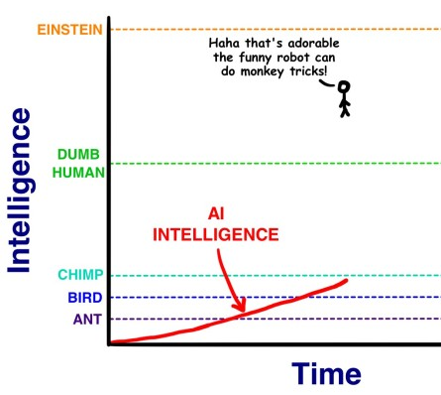
Super AI
Rise of Skynet!
The speed of AI Development
What some think

Slide 22
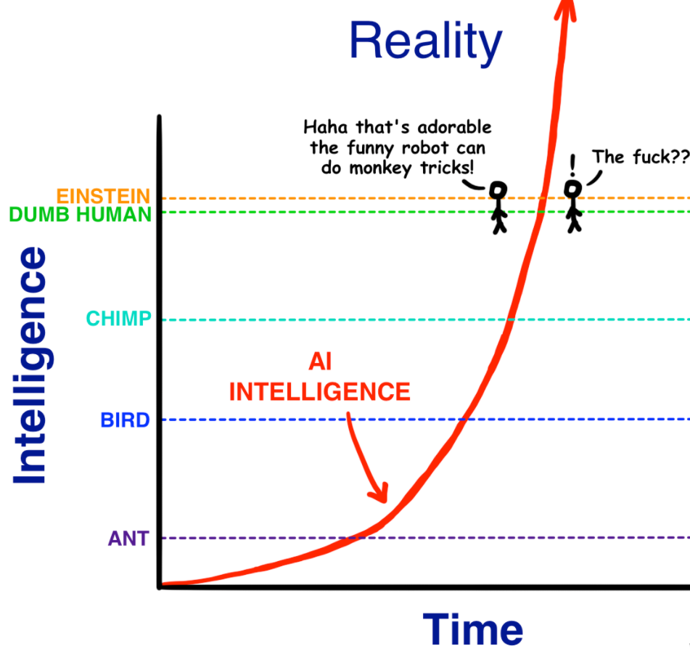
Super AI
Rise of Skynet!
What is happening

Slide 23
Super AI
Super AI is when AI surpasses the human AI in practically every field.
Distance between General AI and Super AI will most likely be very short.
Exponential growth of AI development
AI self improvement
What will happen when Super AI is achieved?
Not sure
Here is article that discusses the different possibilities

Slide 24
Game A.I.
Crosses in the realm of AI but interest is slightly different.
Where AI is wanting to solve the problem of what is intelligence
We care about the illusion of intelligence.
Majority of the time, that’s all we want.

Slide 25
Game A.I.
Game A.I.
AI
Game AI

Slide 26
Game A.I.
Pac-Man
First game with fledgling A.I.
Enemies seemed to conspire against you.
Relied on simple technique
State Machine
Ghosts

Slide 27
Pac-Man (1979)
Ghost states
Chase, Scatter, or Frightened
Each state took a semi-random route at each junction
Chase
Towards the player or random-direction
Scatter
Away from the player or random-direction
Frightened (Power-up / Blue)
Towards a respective corner or random-direction
Each ghost’s states does vary slightly.

Slide 28
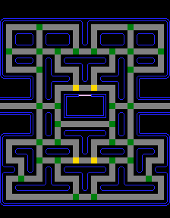
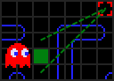
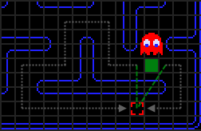

Slide 29
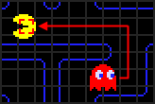
Pac-Man
Red Ghost
“Blinky”
Follows directly behind the Pac-Man
Usually picking the most inefficient path

Slide 30
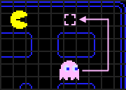
Pac-Man
Pink Ghost
“Pinky”
Attempts to move to where Pac-Man is going

Slide 31
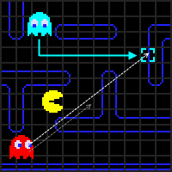
Pac-Man
Blue Ghost
“Inky”
Movement is based on Pac-Man’s position/facing as well as Blinky’s (Red) position
Algorithm
Select 2 tiles infront of Pac-Man
Draw vector from Red Ghost to that tile
Double it
This is Inky’s target.

Slide 32
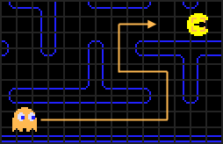
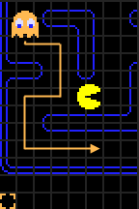
Pac-Man
Orange Ghost
“Clyde”
Doesn’t give a shit about Pac-Man
Algorithm
If Pac-Man is more than 8 tiles away
Home in on Pac-Man
Else scatters

Slide 33
Golden Axe (1987)
One my personal favorites!
Enemies Behavior
Held still (or moved back and forth slightly) until player came into distance
If player is in range, then enemies homes in on player
Unique Innovation
Enemies would rush past the players then switch to homing mode
Attacking player from behind

Slide 34
Fast Forward (90s & 2000s)
Goldeneye 007
One of the first games that added sense simulation.
Enemies were aware when other enemies died
Warcraft
One of he first to accomplish pathfinding A.I.
The Sims
First to accomplish neural network-based brains for each A.I.

Slide 35
Purpose of Game AI
What is the overall goal?
To give the impression of intelligence
A main reason why Game AI differs from other AI research
to avoid the impression of stupidity
To provide a reasonable challenge for the player

Slide 36
Challenge
It is very possible to make the computer too smart
Driving games
Its very easy to predict what player can do
Users are flawed
Computers are precise
Path is predetermined
So how do you make AI challenging but not perfect?
They have to purposely make mistakes
How do you program that?
How do you find a quantifiable balance?

Slide 37
Not Dumb
It is very hard to make the computer not to go full moron.
You want the computer to make believable mistakes
Stupid mistakes can break the experience of the game.
A.I. can easily make your game go from awesome to laughable.
Why is this so hard?
Limited Computational resources
Example: 3-D environments
Humans are good at navigating terrain
For computers to do this efficiently is still an unsolved problem in AI

Slide 38
Game AI
Game AI is an key element to the future of games.
Still many limitations we need to overcome
Model and use emotion
Adapting to user’s abilities and experiences (in game)
The need for level designers to supply guidance for AI agents (i.e. nav meshes)

Slide 39
Lab Hours
During this quarter I will hold outside lab hours
Most likely in Daley 505
We might hold some lectures in Daley 505
You will be notified by email and piazza weeks in advance.

Slide 40
Tools
Visual Studio
Comes with Unity
You can download from MSDNAA Website
Unity 2018
Download link here: link
C#
Working in C#

Slide 41
Plagiarism
Basic Principle
What you turn in should be your own work
If I ask you about any line of code you wrote, you should be able to answer it.

Slide 42
What about help?
What about help?
You are allowed to help one another
But you must disclose that to me for every assignment.
Don’t just copy someone else's code
Usually causes more problems then solves them.
Refactor code, reverse engineer, and make it your own.
Plug in and pray never works!

Slide 43
What I assume
That you can write classes in C#
That you can read C# code and make sense of it
That you can use Visual Studio
That you read the textbook
And understand the code base
If you are uncomfortable with anything above, please come talk to me
We will find a way to make it work.

Slide 44

Version Control
If you have not used any type of version control
This is what your life is missing
And

Slide 45
Reason #1: Freedom
Every change made to your code is tracked
It also tracks who made the change to your code
Further you can roll back to previously submitted code
If you break your solution, roll back to a working one!

Slide 46
Reason #2: Teamwork
It allows you to work on large scale projects with multiple people
Every check-in/check-out is recorded and reconciliation of differences
Means that multiple developers can work on the same project (code)
Without the fear of clobbering each others’ work

Slide 47
Reason #3: Portability
You can work on your program anywhere
Once you submit changes they are part of the master copy
Can work on multiple machines

Slide 48
Reason #4: Backup
Version control allows you to keep another copy of your project
In case of disaster
No more “back up folders”
Old 1
Old 2
Backup 1
Backup new old v.104 good

Slide 49
Basic Idea
Code
Repository
“check-out”
“commit”
“update”
Log
Your computer

Slide 50
Perforce
We will be using perforce
Bit of learning curve
Worth the rewards
We will demo perforce in class
I will also put links to other perforce demos online.

Slide 51
Perforce
All homework and projects will be submitted to perforce
NOT D2L
D2L will only be for posting grades.
Everyone will have their own folder to work out of.
Get in the habit of doing many small check-ins

Slide 52
Submitting Homework/Project
Create a folder in your subdirectory after the name of the assignment.
i.e. Homework 2
Then place your homework in that folder and submit it.
I will search your subdirectory for each assignment and pull it down to my computer.
NOTE: Do submit any temporary files to perforce
No - *.pdb, *.suo, *.sdf, *.user, *.exe, *.log, ...
If it gets generated, do not submit it to perforce
These files take up a lot of space
I will provide a CleanMe.Bat file in my assignments you can use those to help clean up
I will demo this as well later in the course

